Slide 1
Python 3
Business Career Hub

Slide 2
Introduction
Why Machine Learning?
Utilize Big Data
Hardware Improvements
Popular/Common examples
Recommendation Systems
Image Classification
Nature Language Processing
Intuitions
Mapping relationships between Inputs (features) and Outputs (target) of the data
Allow algorithms to find relationships within the data

Slide 3
A Few Definitions
Training/Validation/Test Sets
Training Set
Fed to our model to learn the relationships between the features in the data
Validation Set
Used for model selection. Trained models generate predictions that are tested against the validation set to gauge their effectiveness.
Test Set
Once the best model is found, it is tested again to ensure it is robust and not overfit.
Tuples
Sequence of Immutable Python objects
Values cannot be updated
Defined using parentheses
Accessing values using square brackets similar to lists

Slide 4
Classification
Used for classifying data into discrete classes
E.g: Dog Breeds, Plant types, etc.
Goal: Predict the label of a data point from its feature data
Multiple different classification algorithms to choose from for classification purposes
Logistic Regression (Binary Classification)
Linear Discriminant Analysis (LDA)
K - Nearest Neighbors (KNN)
Decision Tree Classifier
Gaussian Naive Bayes
Support Vector Machines (SVM)

Slide 5
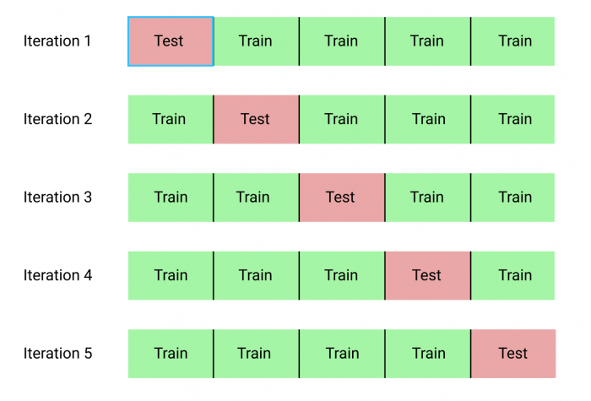
Appendix
K fold validation

Slide 6
Additional Resources
Massive Open Online Courses (MOOC)
Coursera
“Machine Learning” and “Deep Learning” by Andrew Ng of Stanford University
Fast.ai
EDX
CS229 - Stanford U.
Research Papers
Arxiv.org
jmlr.org

